Slide 1

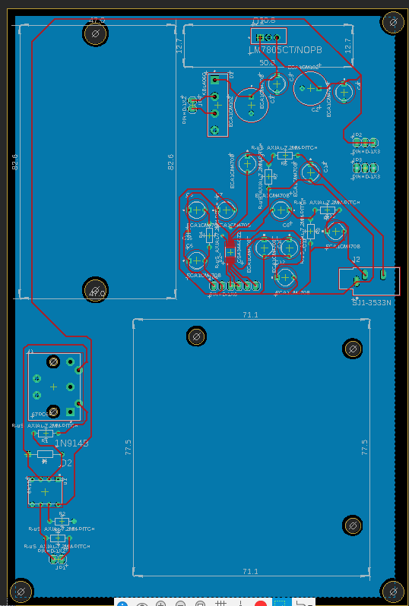
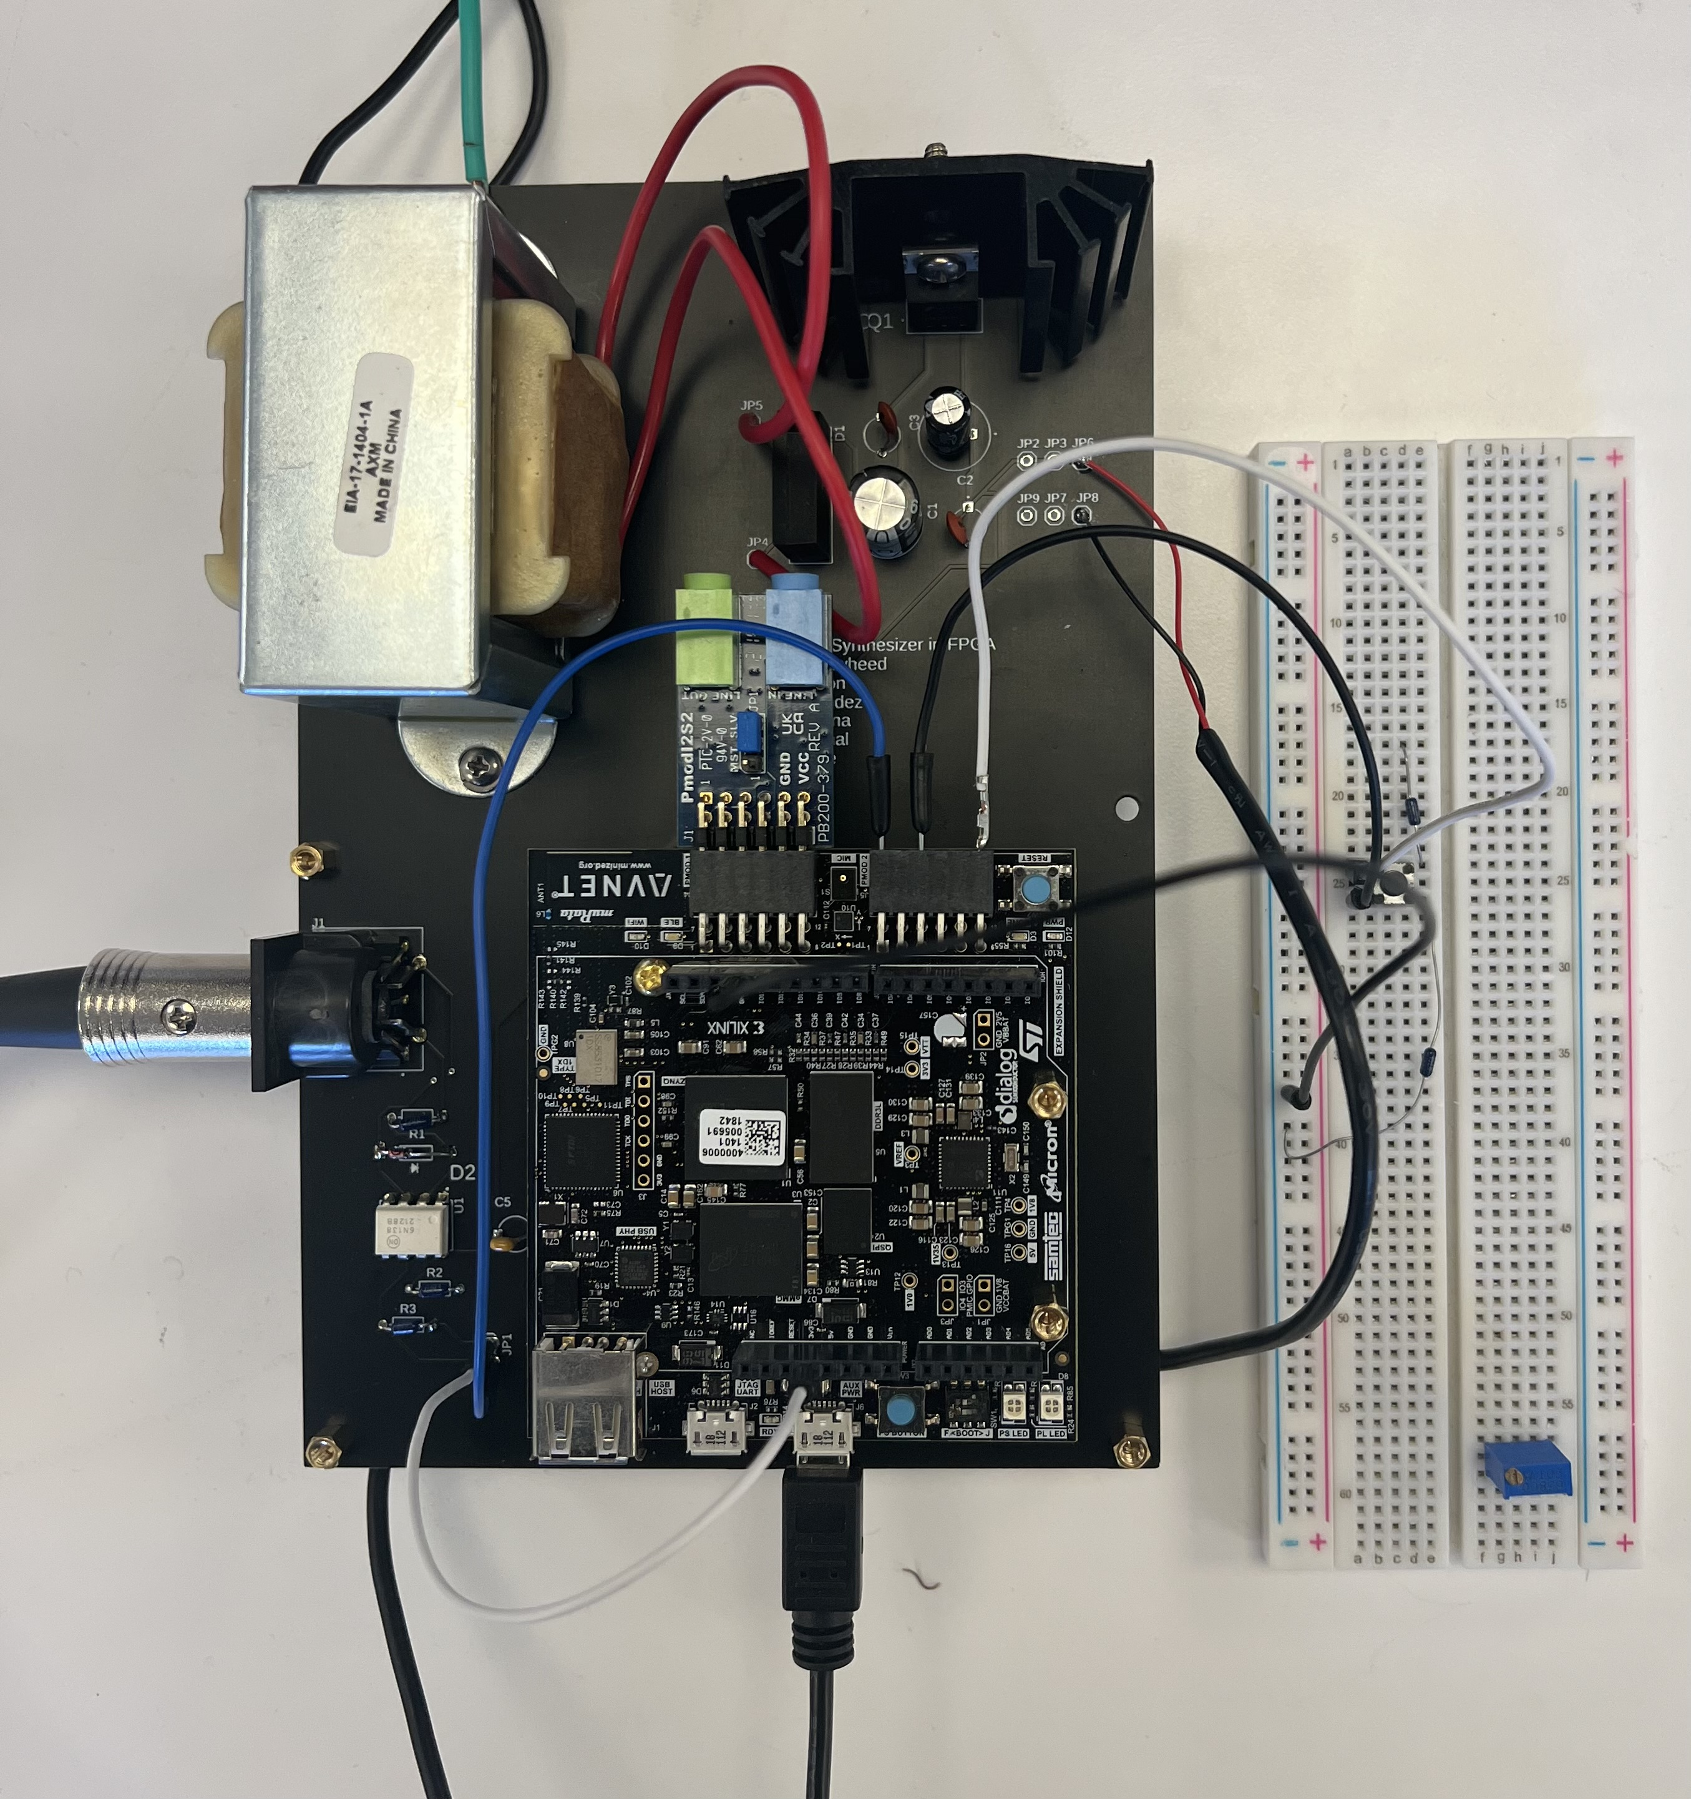







FM Music Synthesizer on FPGA
By The Synthesizers
Department of Electrical and Computer Engineering
Project Overview
System Process Overview
Enclosure
Our 16-channel FM Music Synthesizer connects to MIDI-supported keyboards and applies frequency modulation to the notes being played. A user interface and LCD display allows customization of modulation parameters as well as waveform selection (Sine, Square, Sawtooth, Triangle). The SoC's processor decodes the MIDI data and the FPGA implements custom RTL to generate and modulate the requested notes. DSP is accomplished using fixed-point arithmetic to balance resources and numerical accuracy. An ADSR (Attack, Decay, Sustain, Release) envelope is applied to both the carrier and modulator signals to create a time-varying FM signal. The digital signal is converted to analog using a 24-bit DAC. A low-pass reconstruction filter is applied to the signal before it is output via a 3.5mm audio jack.
PCB
Prototype
The Team
FM Datapath
Budget: $225
$$A\left(t\right)cos⁡(ω_{c}t+cm\left(t\right))$$
Elisha Reece
Tiber Hernandez
Andres Medina
Tharaa Rahhal
Abdul Altawheed
Michael Fallon

